Slide 1

Introduction – Modern UI Apps
4NET
SUPINFO Official Document
Notes:
© SUPINFO International University - http://www.supinfo.com
SUPINFO vous permet de partager ce document
Vous êtes libre de :
Partager — reproduire, distribuer et communiquer ce document Remixer — modifier ce document
A condition de respecter les règles suivantes :
Indication obligatoire de la paternité — Vous devez obligatoirement préciser l’origine « SUPINFO » du document au début de celui-ci de la même manière qu’indiqué par SUPINFO International University – Notamment en laissant obligatoirement la première et la dernière page du document, mais pas d'une manière qui suggérerait que SUPINFO International University vous soutiennent ou approuvent votre utilisation du document, surtout si vous le modifiez. Dans ce dernier cas, il vous faudra obligatoirement supprimer le texte « SUPINFO Official Document » en tête de page et préciser notamment la page indiquant votre identité et les modifications principales apportées.
En dehors de ces dispositions, aucune autre modification de la première et de la dernière page du document n’est autorisée.
NOTE IMPORTANTE : Ce document est mis à disposition selon le contrat CC-BY-NC-SA Creative Commons disponible en ligne http://creativecommons.org/licenses ou par courrier postal à Creative Commons, 171 Second Street, Suite 300, San Francisco, California 94105, USA modifié en ce sens que la première et la dernière page du document ne peuvent être supprimées en cas de reproduction, distribution, communication ou modification. Vous pouvez donc reproduire, remixer, arranger et adapter ce document à des fins non commerciales tant que vous respectez les règles de paternité et que les nouveaux documents sont protégés selon des termes identiques. Les autorisations au-delà du champ de cette licence peuvent être obtenues à support@supinfo.com.
© SUPINFO International University – EDUCINVEST - Rue Ducale, 29 - 1000 Brussels Belgium . www.supinfo.com

Slide 2

Objectives
Introduction – Modern UI Apps
By completing this course, you’ll be able to:
Understand why Microsoft changed its UI
Explain Universal Apps layout concept
Know which development tools to use

Slide 3


Course plan
Introduction – Modern UI Apps
Universal Apps?
Modern UI Design

Slide 4

Universal apps?
Introduction – Modern UI Apps

Slide 5

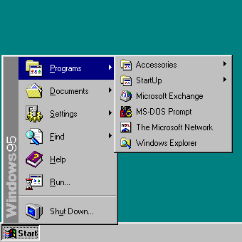
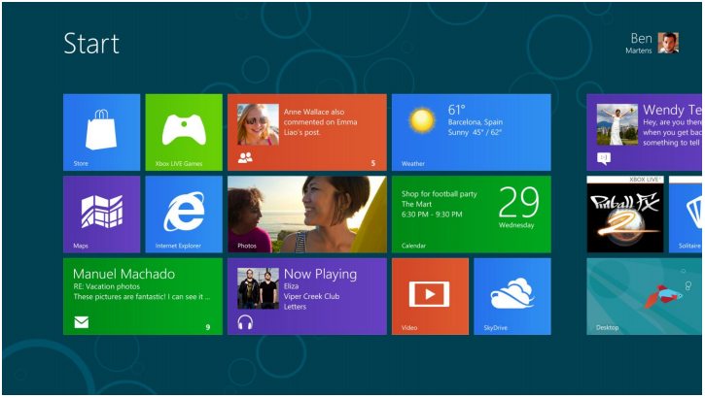
Win8: Biggest change since Win95
Universal Apps?
Windows 8 has been completely reimagined
No more Start Menu : New fast, fluid Start Screen
Optimized for touch mouse and keyboard
Biggest change in UI since Win 95

Slide 6
The Win8 Experience
Universal Apps?
Fast and fluid UX
Immersive and full-screen
Touch-First
Cloud Orientated
All PCs and Architectures

Slide 7

What’s new?
Universal Apps?
New Windows Runtime (aka WinRT)
Brand new user experience
New Execution Environment
Windows Store

Slide 8
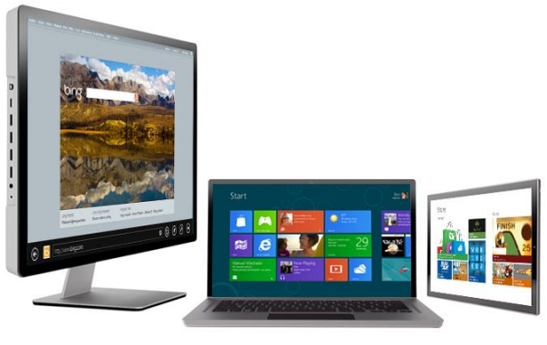
Optimized for different hardware
Universal Apps?
Windows 8 works on
Tablets
All-in-ones
Laptops
Desktops
So does Windows 10

Slide 9
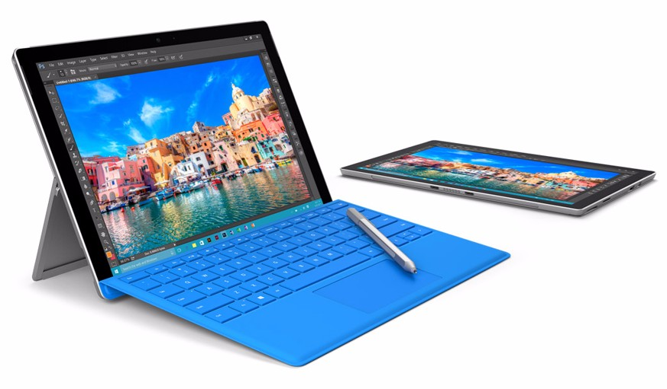
Computers are redesigned everyday
Universal Apps?
Tablets of different sizes
With any operating system in it
Computer screens are tactile
Mimics mouse behavior with finger taps
Tablets & computers are merging day after day

Slide 10
Universal Apps
Universal Apps?
Universal Apps allow developers to create applications working on every device embedding a Microsoft operating system.
It’s fully independant of input methods (gestures/mouse/keyboard)
Notes:
Windows Phone, Windows RT, Windows 8+

Slide 11
Still .NET Framework
Universal Apps?
Many languages to develop Universal Apps
Still compiled to create equivalent applications
Choose your weapon and start to develop!

Slide 12
Universal Apps Dev Platform
Universal Apps?
Windows Store Apps
Desktop Apps
XAML
C#
VB
C
C#
HTML / CSS
HTML
JavaScript
C
C++
C#
VB
JavaScript (Chakra)
WinRT APIs
Communication & Data
Graphics & Media
Devices & Printing
Internet
Explorer
Win32
.NET / SL
Application Model
Windows Core OS Services

Slide 13
Web languages supported!
Universal Apps?
Windows Store Apps
Desktop Apps
XAML
C#
VB
C
C#
HTML / CSS
HTML
JavaScript
C
C++
C#
VB
JavaScript (Chakra)
Projections
WinRT APIs
Communication & Data
Graphics & Media
Devices & Printing
Internet
Explorer
Win32
.NET / SL
Application Model
Windows Core OS Services

Slide 14
Language projections
Universal Apps?
C++ App
Windows Runtime Object
(or Component)
Projection
CLR
C#/VB App
Projection
CLR
HTML App
Windows Metadata
Projection
Notes:
https://community.devexpress.com/blogs/seth/archive/2011/09/23/what-is-the-winrt-windows-runtime-and-what-does-it-have-to-do-with-net.aspx
http://blogs.msdn.com/b/thunbrynt/archive/2012/06/13/vs-2012-winrt-and-language-projection.aspx

Slide 15
User Experience
Universal Apps?
Design is very important with Universal Apps
You’ll deal with many devices
Many resolutions
Many input methods
Gestures
Mouse
Follow Microsoft Modern UI guidelines please! ☺
https://msdn.microsoft.com/fr-fr/library/windows/apps/hh465424.aspx

Slide 16
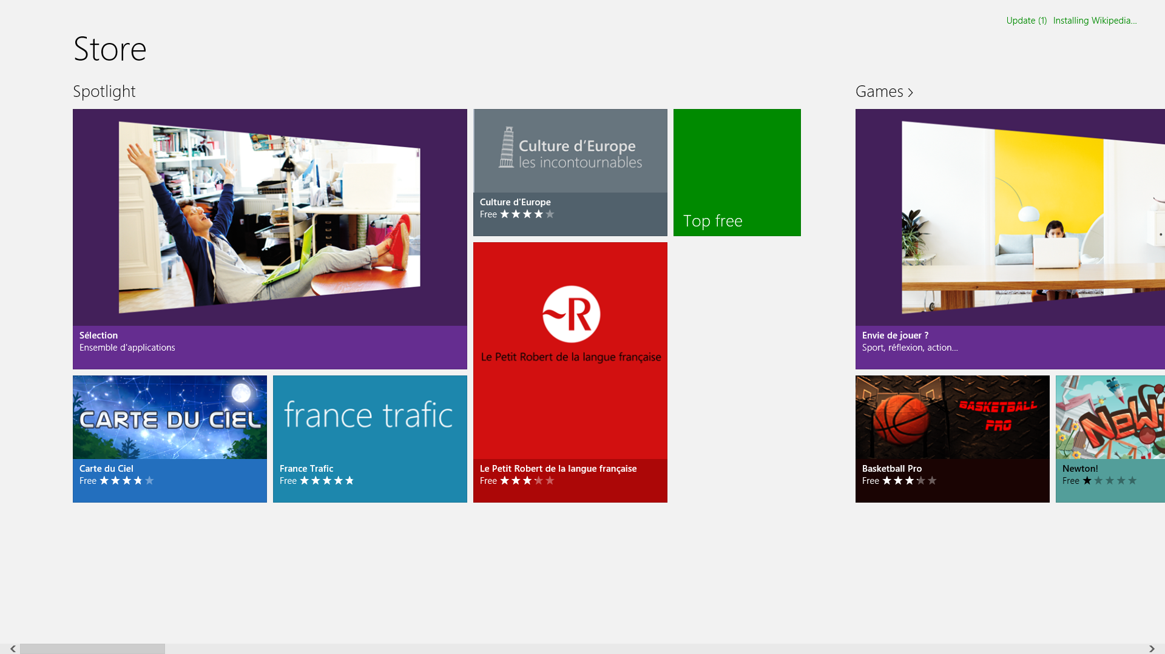
Modern UI
Introduction – Modern UI Apps

Slide 17

Chrome vs Content
Modern UI
We’ll separate Chrome and Content for this course
Chrome: Tabs, Menus, Icon, Buttons…
Everything that isn’t content
Content: For what we opened the app
Movie, Picture, Text, Document, …
What we really want to see!
Notes:
In Windows 8 and further, content comes first. It immerse users in the things they love… And leave only relevant elements on screen
Traditionally chrome is added for layout (borders, icon, app name, …), interactions (menus, ribbon, …), navigation (links)

Slide 18
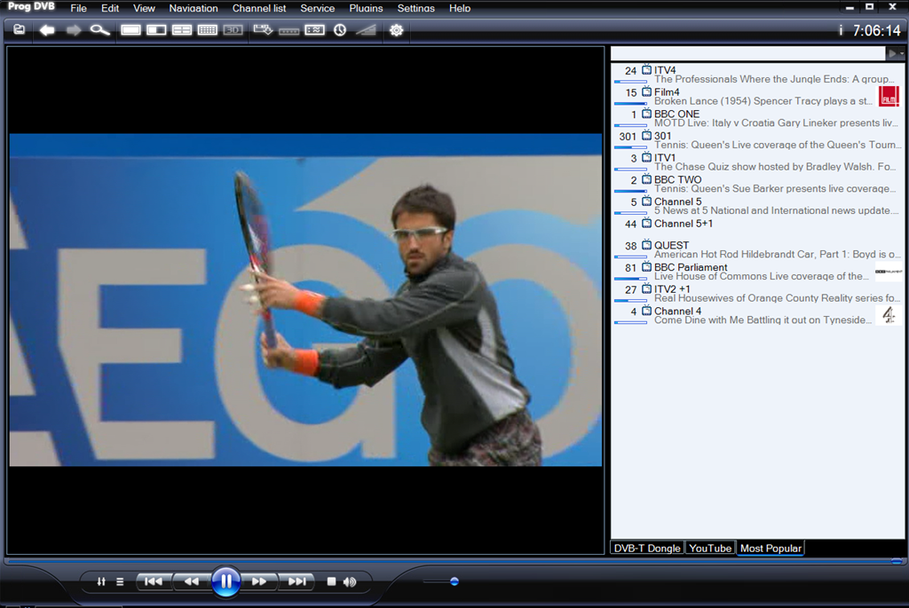
Chrome before Content
Modern UI

Slide 19
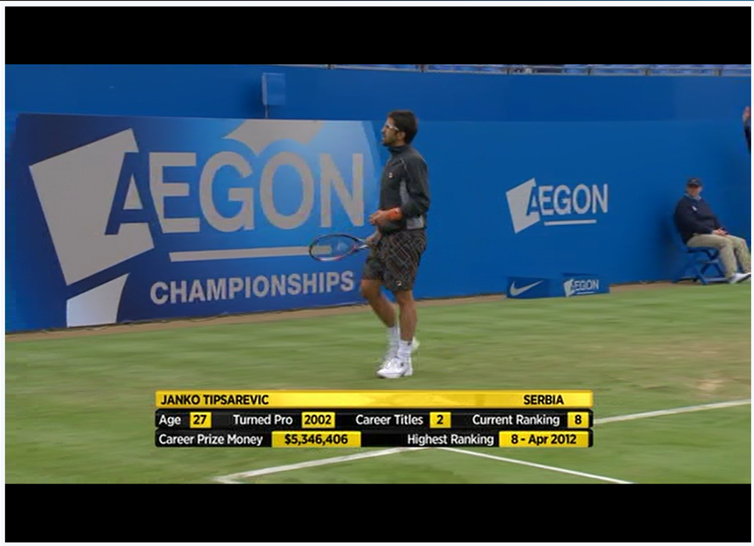
Content before Chrome
Modern UI

Slide 20
UI Components
Modern UI

Slide 21
Layout
Modern UI
Give content breathing room
Intentional space frames the content and allows your eyes to focus on the right thing
Remove lines and boxes as a way to group and organize content
Epuré pour nous permettre de voir uniquement les choses importantes

Slide 22
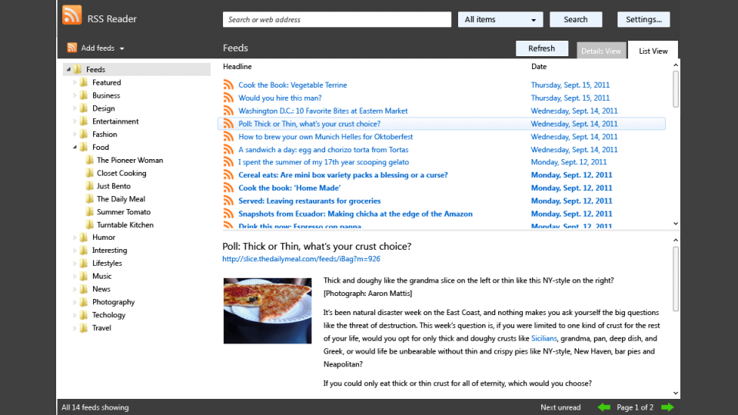
Layout with Chrome
Modern UI

Slide 23
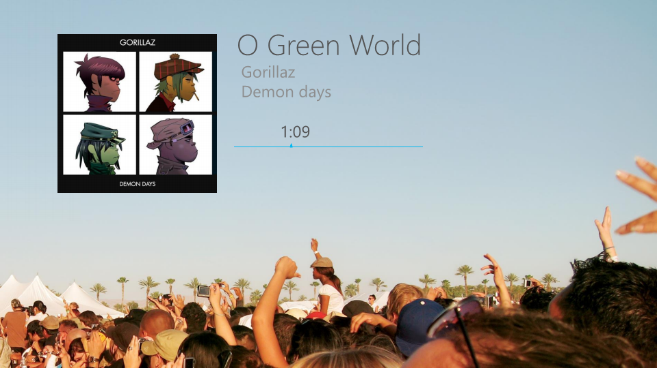
Layout in Windows 8
Modern UI
Notes:
Of course, red bars are just a way to show you the layout. They aren’t displayed in the actual app.

Slide 24
Layout
Modern UI
Use of Typography:
Create a sense of structure and hierarchy in your content
Fixed set of sizes, weights, colors
Convey information on a piece of content’s importance
Default style sheet to get classical app styling

Slide 25
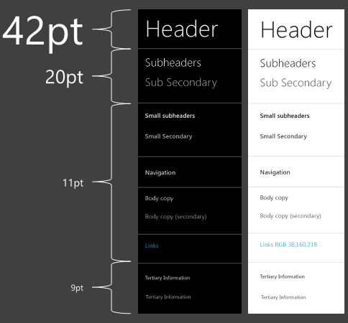
Layout
Modern UI

Slide 26
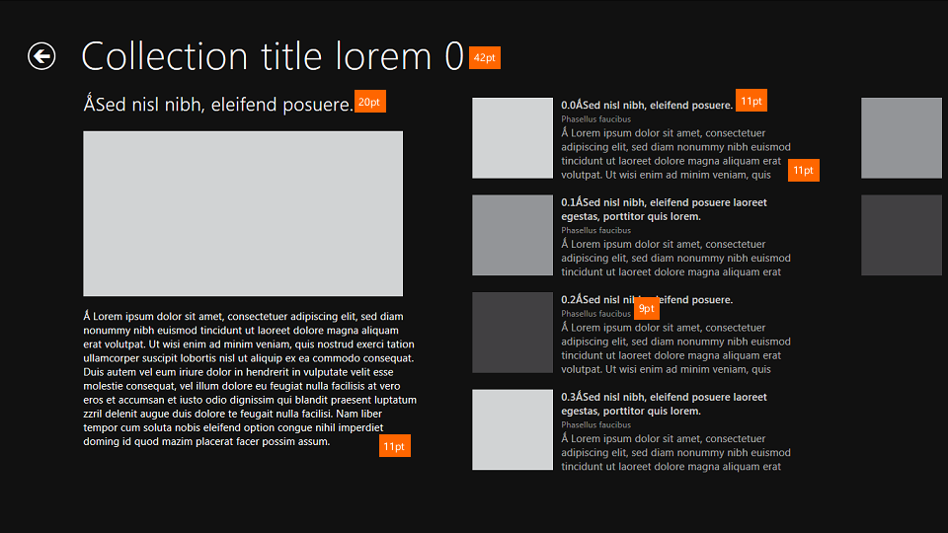
Layout
Modern UI

Slide 27
Layout
Modern UI
Let content flow from edge to edge
Visual alignment, structure & clarity
Align elements on a grid to make it structured & consistent
Maintain a feeling of stability in every app
User already know how your app works
Keep ergonomics in mind

Slide 28
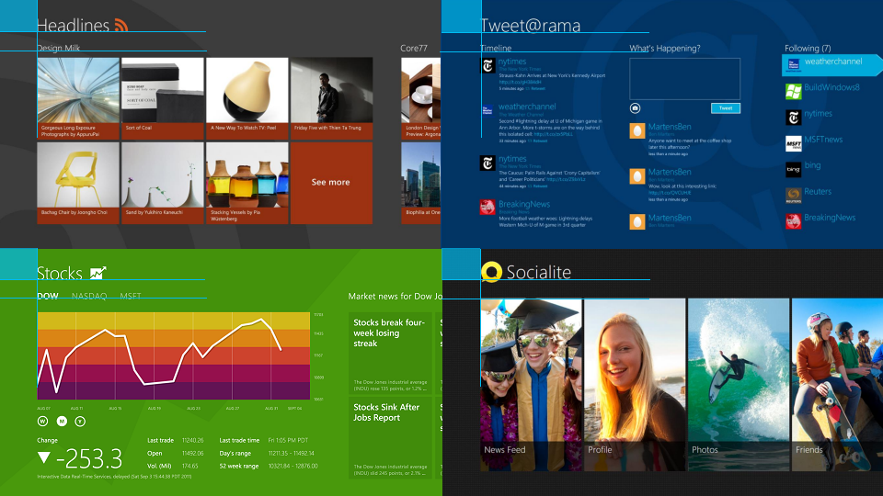
Layout
Modern UI

Slide 29
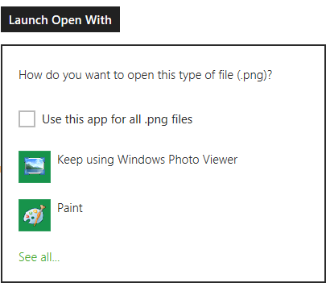
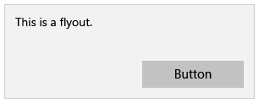
Flyout
Modern UI
Lightweight way of showing transient, contextual UI
Over content
Ask for user data or confirm

Slide 30

Errors
Modern UI
Show errors inline when possible
Keep user focused

Slide 31
Navigation
Modern UI
Views should be about where you are at…
Not where you might go!
Integrate navigational elements into the content
Avoid persistent way finding chrome (ex. Tabs)

Slide 32
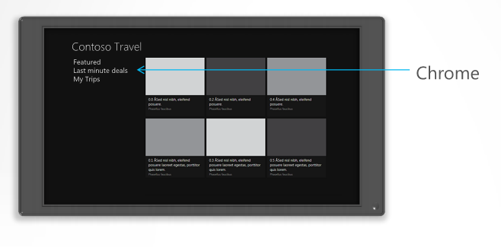
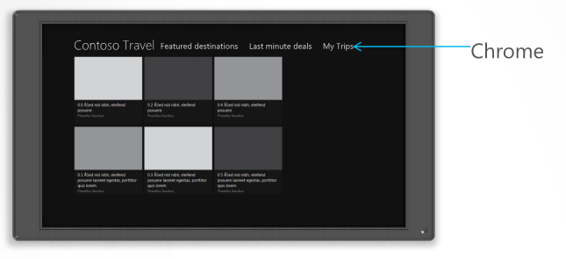
Bad vs Good Navigation in Chrome
Modern UI

Slide 33
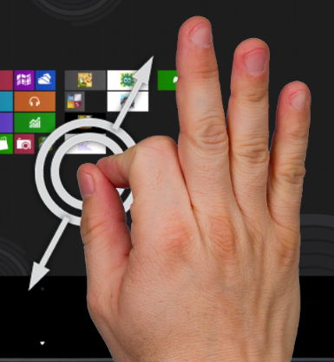
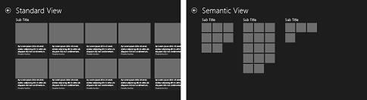
Semantic Zoom
Modern UI
Zoomed-out view should show more information
Keep the same content scope!

Slide 34
Animations
Modern UI
Widely used in the Microsoft Design Language
Bring life to Universal Apps
Make the experience feel crafted and polished
Animations are purposeful not visual adornment
Find animation library in comments
Notes:
App Navigation
Enter / Exit Page
Animate Content
Enter Content / Exit Content
Expand / Collapse
Reposition
Crossfade
Fade in / Fade Out
Peek
Update Badge
Reveal / Hide
Selection
Pointer animations
Swipe Select / Swipe Deselect
Swipe Reveal
Show or Hide Supplemental UI
Show Edge UI / Hide Edge UI
Show Panel / Hide Panel
Show Pop Up / Hide Pop Up
Collections and list
Add / Delete item
Drag and Drop

Slide 35
Touch First Design
Modern UI
Provide instant visual feedback on touch down, commit on touch up
Actions should be reversible so users can explore
Think beyond tap and take advantage of sliding : Content should always follow your fingers
Pan in 1 axis only

Slide 36
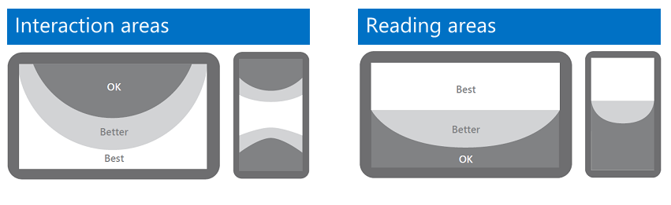
Touch First Design
Modern UI
Design with fingers in mind:
Notes:
1) OK -
2) Better +
3) Best +++

Slide 37
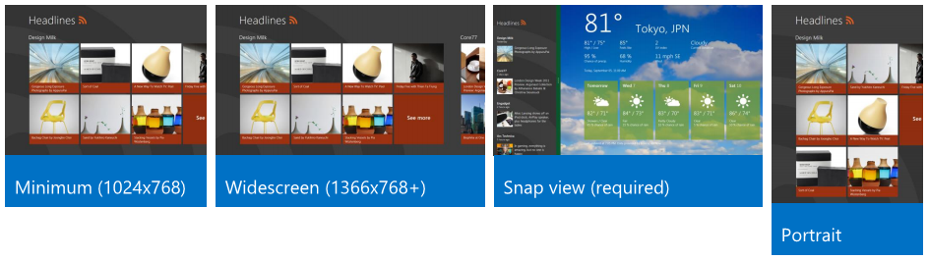
Design for multiple views
Modern UI
People are multitask. So should be your apps!
Multiple layouts for your applications

Slide 38
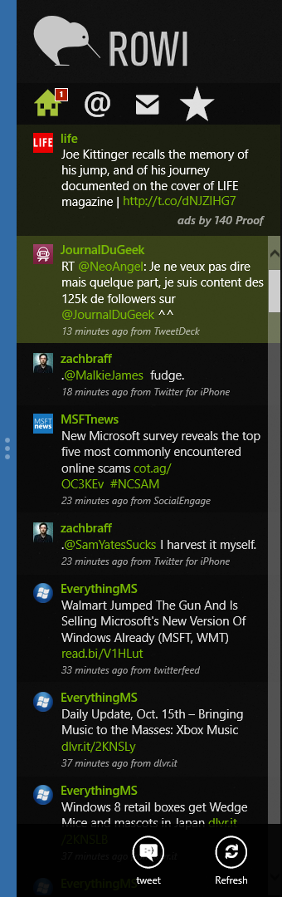
Snap
Modern UI
Snapping is a built-in Windows 8 Scenario
A great snapped view keeps app on screen
Design a purposeful snapped state
Vertical panning for ergonomics
Maintain state across snapping
Don’t lose the user’s work

Slide 39
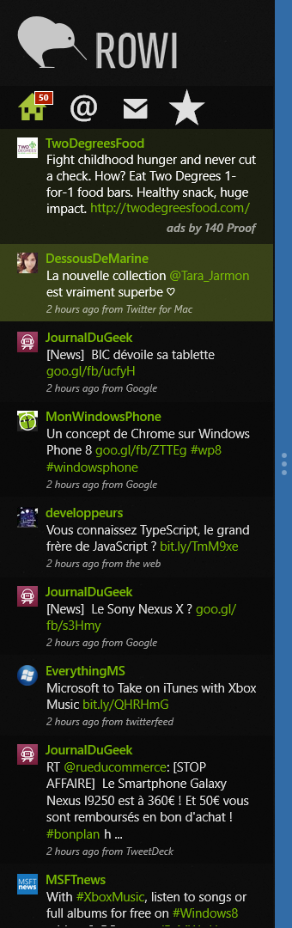
Snap
Modern UI
All apps are snap-able
Some UI advices:
Max 5 buttons per row
Appbar ones have labels
Group commands in a way that make sense

Slide 40
Scaling
Modern UI
The minimum app resolution is 1024x768
A good place to start designing your app is 1366x768
Apps take advantage of added screen real-estate
Show more content
Manage white space

Slide 41

Tooling
Introduction – Modern UI Apps

Slide 42
Let me guess… Visual Studio?
Tooling
You’re right!
Prerequisites for Universal Apps:
Visual Studio 2012 Ultimate or Professional.
Visual Studio Express for Windows 8 Edition.
Don’t need to install SDK but your Visual Studio needs to be installed on Windows 8

Slide 43
Exercise
Tooling
Create a new Hub Universal App (C#)
Models > C# > Windows Store Apps > Universal Apps
Launch it!
Discover with your teacher folders and files

Slide 44

The End
Introduction to Modern UI Apps
That’s all folks!

